Slide 1
Interpreting Sleep Study Reports:
A Primer for Pulmonary Fellows
By Martha E. Billings, MD MSc
for the Sleep Education for Pulmonary Fellows and Practitioners, SRN ATS Committee
August 18, 2014

Slide 2
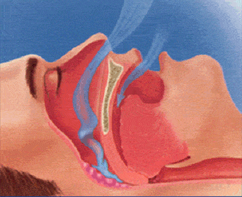
Obstructive Sleep Apnea
Obstructive sleep apnea: repeated closure or narrowing of upper airway reducing airflow
Apnea: total cessation of air flow for 10 sec
Hypopnea: 10 sec of reduced air flow
Obstructive respiratory events are associated with snoring, thoracoabdomnial paradox & increasing effort
AASM Scoring Manual Version 2.1, 2014
Notes:
RDI is apnea and hypopnea events per hr of sleep
2

Slide 3
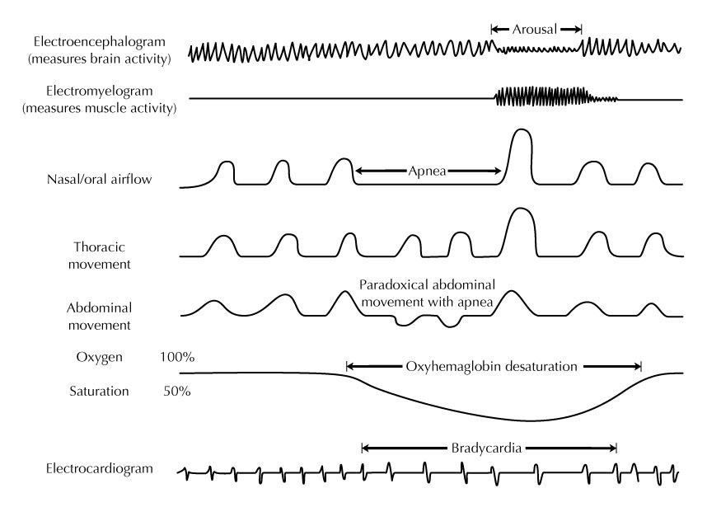
Polysomnogram (PSG)
Warvedaker NV et al. Best Practice of Medicine. Sept. 1999

Slide 4
Scoring Criteria: Respiratory Events
Hypopnea definition
↓ flow ≥ 30% from baseline for at least 10 seconds
1A. (AASM) with 3% O₂ desaturation OR arousal
    Requires EEG monitoring
1B. (CMS) with 4% O₂ desaturation
Amenable to portable studies
Respiratory Effort Related Arousal (RERA)
Flattening of inspiratory portion of nasal pressure (or PAP flow) with increasing respiratory effort leading to arousal
No associated desaturation
    Requires EEG monitoring
AASM Scoring Manual Version 2.1, 2014

Slide 5
Apnea Hypopnea Index
AHI = (# apneas + # hypopneas) / sleep hours
    AHI < 5 normal
    AHI 5 – 15 mild
    AHI 15 – 30 moderate
    AHI > 30 severe
RDI = (# apneas + # hypopneas + # RERAs) / sleep hours
  Can be large difference in AHI vs. RDI if young, thin patient who is less likely to desaturate by 4% with events
  Treatment not covered by Medicare if AHI < 5 but some insurances accept RDI >5 (with AHI < 5) with symptoms

Slide 6
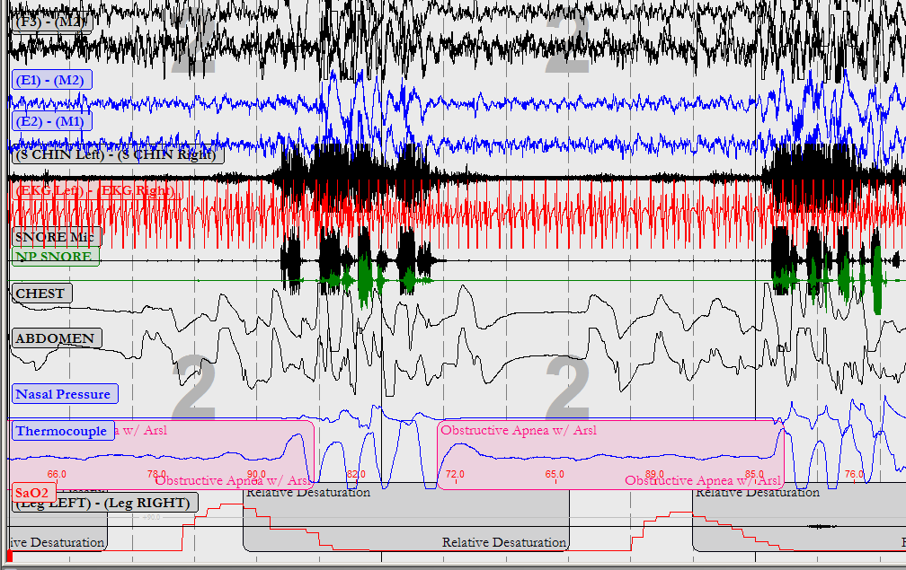
PSG Epoch: Obstructive Apneas

Slide 7
In-lab PSG Data
Respiratory Data:
# Central, obstructive apneas, hypopneas & RERAs
  AHI & RDI by position and sleep stage
  Central apnea index & if Cheyne-Stokes pattern
Oximetry:
  Oxygen Desaturation Index
  Mean O₂ saturation & nadir
Hypoxemic burden
  ̶ Cumulative % of sleep time spent under 90%

Slide 8
In-lab PSG Data
EEG Data:
Sleep efficiency & latency
  Normal 80% efficient
  Latency < 30 min, REM latency 60-120 min
Sleep stages & architecture
  Normal about 5% stage N1, 50% N2, 20% N3 (slow wave sleep) and 20-25% REM
Arousal Index (AI): sleep disruption
  Normal AI < 10-25 (large variation by age)
Norms are all age dependent
  in general less REM & SWS, more arousals, WASO and lower sleep efficiency as age
EEG abnormalities
  Epileptiform activity, alpha intrusion
Notes:
No clear norms of arousal index. It is well established that arousals are a normal part of sleep and tend to increase in frequency with age.
In young adults, average arousal index of 10, while middle aged adults 15-20, elderly may be as high as 25
WASO = wake after sleep onset

Slide 9
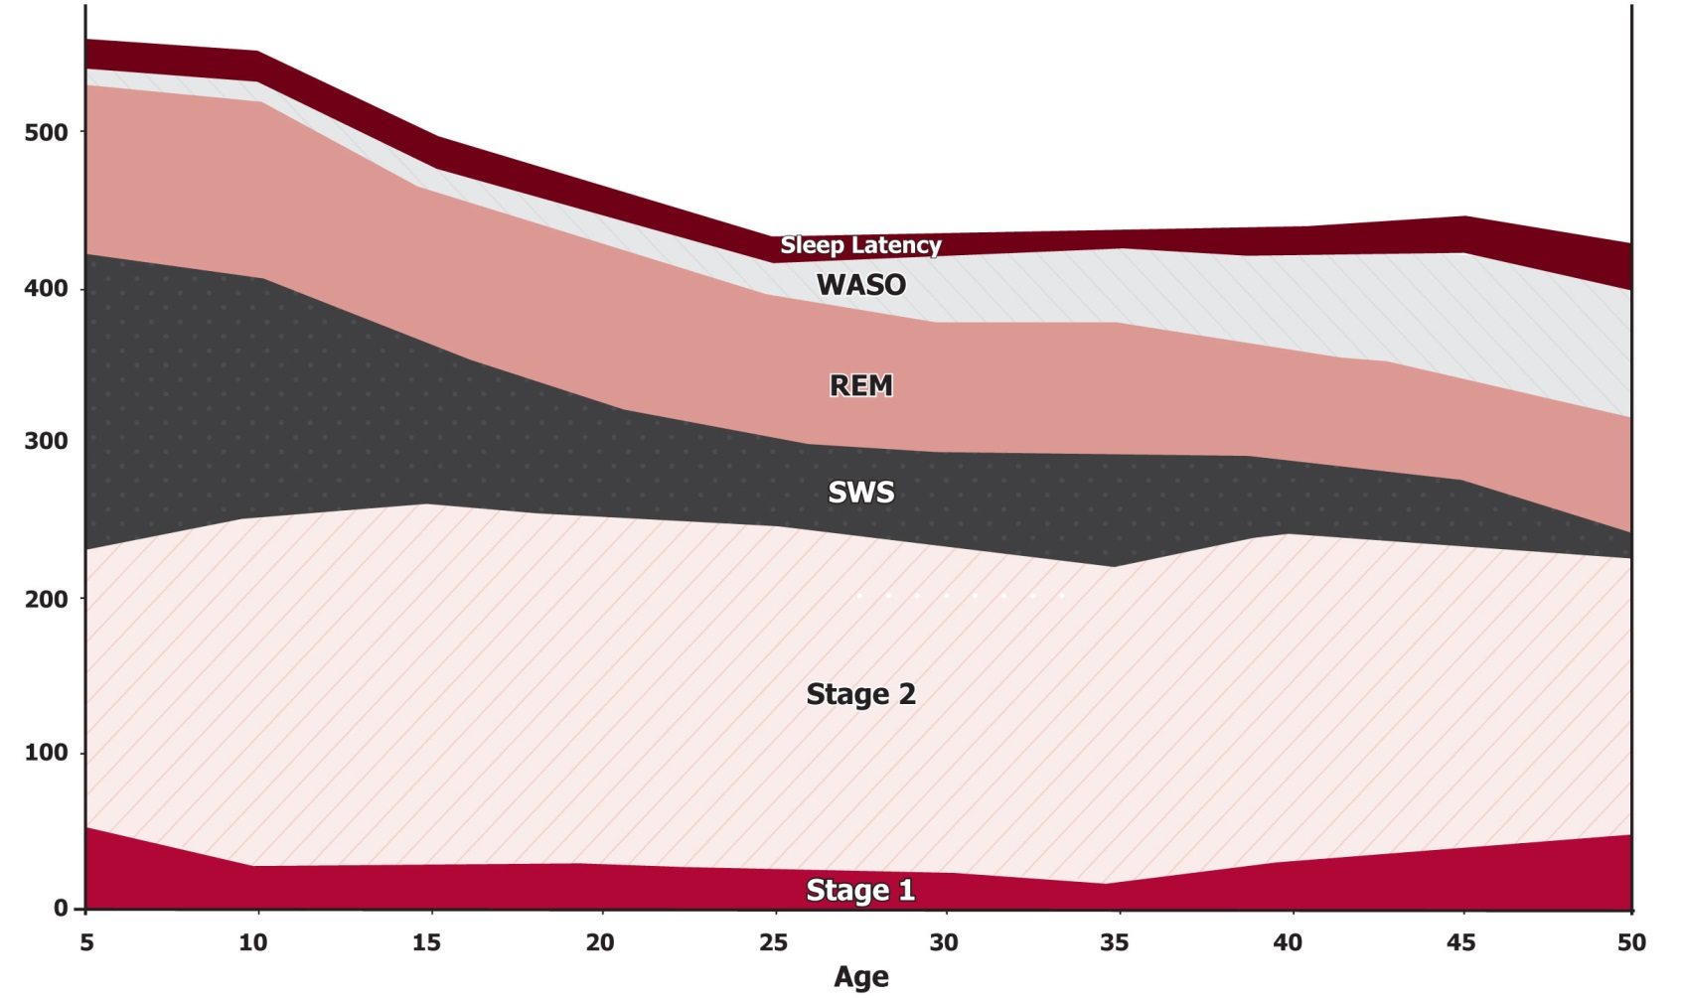
Sleep Architecture Over Lifespan
Ohayon MM, Carskadon MA, Guilleminault C, Vitiello MV. Meta-analysis of quantitative sleep parameters from childhood to old age in healthy individuals: developing normative sleep values across the human lifespan. Sleep 2004;27(7):1255-73

Slide 10
In-lab PSG Data
EMG Data & Video
Limb Movements
  periodic limb movements index in wake & sleep
    Normal PLMI < 15 adults
  Movements during REM (loss of atonia)
Parasomnias
  Sleep walking, talking
  Bruxism
  REM sleep behavior disorder

Slide 11
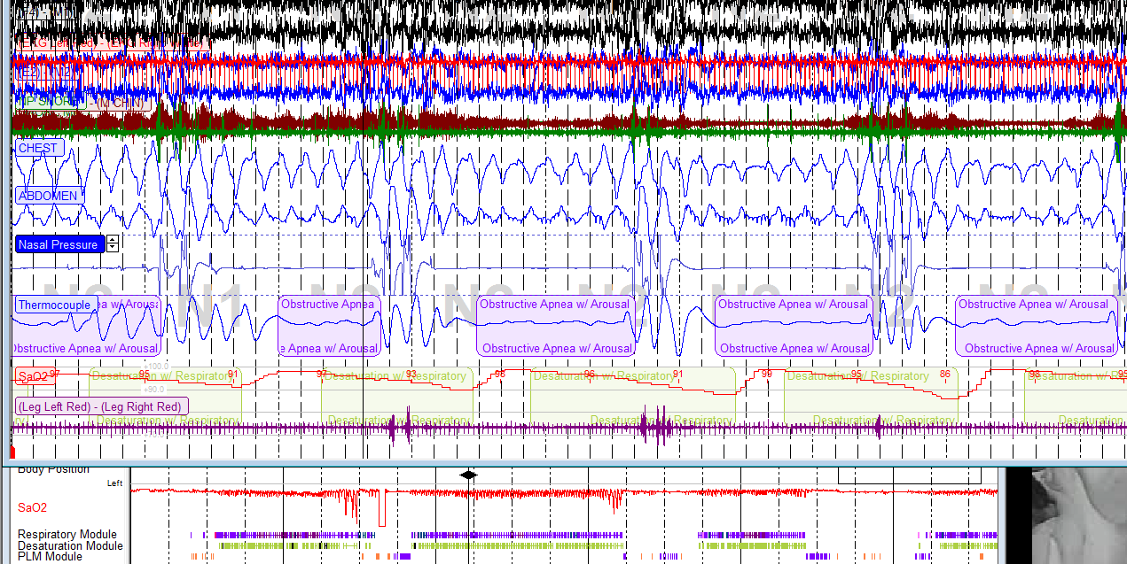
Classic OSA (300 sec)

Slide 12
Sample PSG Results
Sleep Architecture:
  Sleep latency 13 min
  Sleep efficiency 64%
  WASO 28%
  REM latency 143 min
Arousal index 53
  Predominantly respiratory
Limb Movements
  PLM index 7
Notes:
Normal PSG results:
Normal 5% N1, 50% N2, 20% SWS/N3 and 20-25% REM
Normal sleep efficiency >80-85%
Sleep onset latency < 30 min, REM latency < 120 min
Arousal index < 10
PLM index < 5
In OSA & other sleep disorders, increased N1 (light sleep), decreased REM (OSA more severe)

Slide 13
Sleep Study Sample Report
EEG Data: sleep architecture & arousals
Notes:
This patient has relatively normal sleep stages and efficiency and latency for the sleep lab. She did have increased arousals due to respiratory events.

Slide 14
Sample PSG Results: OSA
Respiratory Data:
  Apnea Hypopnea Index: AHI 17
    12 obstructive apneas, 45 hypopneas
    RERA index 34
  Oxygenation Desaturation Index: ODI 13
    Nadir O₂Saturation: 86%
    Hypoxemic Burden: 13% of study O₂ sat < 90%
  Most severe supine, REM sleep (AHI 53)
  Total RDI: 55
Notes:
Notice difference in RDI 55 from AHI 17 – moderate vs. severe OSA. The patient does not desaturate frequently but clearly has sleep disruption from respiratory events.

Slide 15
Sample PSG Report
Events by sleep stage & position
Notes:
This patient had severe obstructive sleep apnea (AHI 39), no central events and had frequent desaturation

Slide 16
Respiratory Events by Position
TST in Position: % of TST | Supine |  | Prone |  | Left |  | Right |  | Upright
 | 206.9 min. |  | 0.0 min. |  | 154.1 min. |  | 29.5 min. |  | 0.0 min.
 | 53.0% |  | 0.0% |  | 39.5% |  | 7.6% |  | 0.0%
 | Number | Index | Number | Index | Number | Index | Number | Index | Number | Index
Obstructive Apneas | 2 | 0.6 | N/A | N/A | 7 | 2.7 | 0 | 0.0 | N/A | N/A
Mixed Apneas | 0 | 0.0 | N/A | N/A | 0 | 0.0 | 0 | 0.0 | N/A | N/A
Central Apneas | 1 | 0.3 | N/A | N/A | 1 | 0.4 | 0 | 0.0 | N/A | N/A
Total Apneas | 3 | 0.9 | N/A | N/A | 8 | 3.1 | 0 | 0.0 | N/A | N/A
Total Hypopneas | 80 | 23.2 | N/A | N/A | 56 | 21.8 | 10 | 20.3 | N/A | N/A
Apneas + Hypops | 83 | 24.1 | N/A | N/A | 64 | 24.9 | 10 | 20.3 | N/A | N/A
NREM TST in Position: % of TST: |  | Supine | Prone | Left |  | Right | Upright | Total
 |  | 189.4 | 0.0 | 125.6 |  | 7.5 | 0.0 | 322.5
 |  | 48.5% | 0.0% | 32.2% |  | 1.9% | 0.0% | 82.6%
Obstructive Apneas | 2 |  | N/A | 6 | 0 |  | N/A | 8
Mixed Apneas | 0 |  | N/A | 0 | 0 |  | N/A | 0
Central Apneas | 1 |  | N/A | 1 | 0 |  | N/A | 2
Total Apneas | 3 |  | N/A | 7 | 0 |  | N/A | 10
Total Hypopneas | 60 |  | N/A | 44 | 0 |  | N/A | 104
Apneas + Hypops | 63 |  | N/A | 51 | 0 |  | N/A | 114
AHI | 20.0 |  | N/A | 24.4 | 0.0 |  | N/A | 21.2
REM TST in Position: % of TST: |  | Supine | Prone | Left |  | Right | Upright | Total
 |  | 17.5 | 0.0 | 28.5 |  | 22.0 | 0.0 | 68.0
 |  | 4.5% | 0.0% | 7.3% |  | 5.6% | 0.0% | 17.4%
Obstructive Apneas | 0 |  | N/A | 1 | 0 |  | N/A | 1
Mixed Apneas | 0 |  | N/A | 0 | 0 |  | N/A | 0
Central Apneas | 0 |  | N/A | 0 | 0 |  | N/A | 0
Total Apneas | 0 |  | N/A | 1 | 0 |  | N/A | 1
Total Hypopneas | 20 |  | N/A | 12 | 10 |  | N/A | 42
Apneas + Hypops | 20 |  | N/A | 13 | 10 |  | N/A | 43
AHI | 68.6 |  | N/A | 27.4 | 27.3 |  | N/A | 37.9
Notes:
Notice OSA in all positions captured but certainly worse during REM sleep, especially supine REM.

Slide 17
Sample Hypnogram
Notes:
More events clustered around REM sleep with more severe desaturation. This was a split night study and CPAP is initiated around 1am.

Slide 18
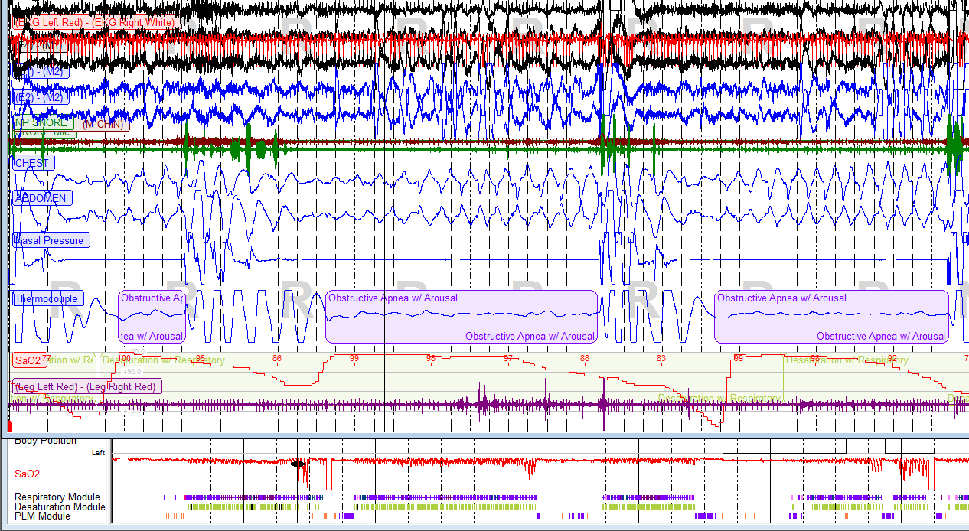
Dramatic OSA in REM

Slide 19
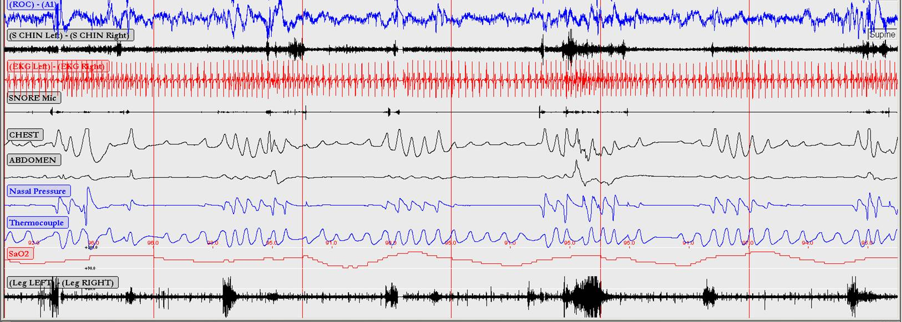
PSG: 120sec Epoch
Obstructive hypopneas/ RERAs with clear arousals but not consistent desaturation

Slide 20
Home Sleep Study (OCST)
Respiratory data only (estimated AHI, ODI) calculated from recording time
  Underestimates AHI as recording time > time asleep
  Problematic if insomnia
No EEG to determine sleep or arousal
  No arousal associated hypopneas scored
  No respiratory effort related arousals (RERAs)
  No information by sleep stage (REM/NREM or if asleep)
Higher rates of technical failure
Appropriate for high likelihood OSA & no other sleep disorders or respiratory/cardiac disease

Slide 21
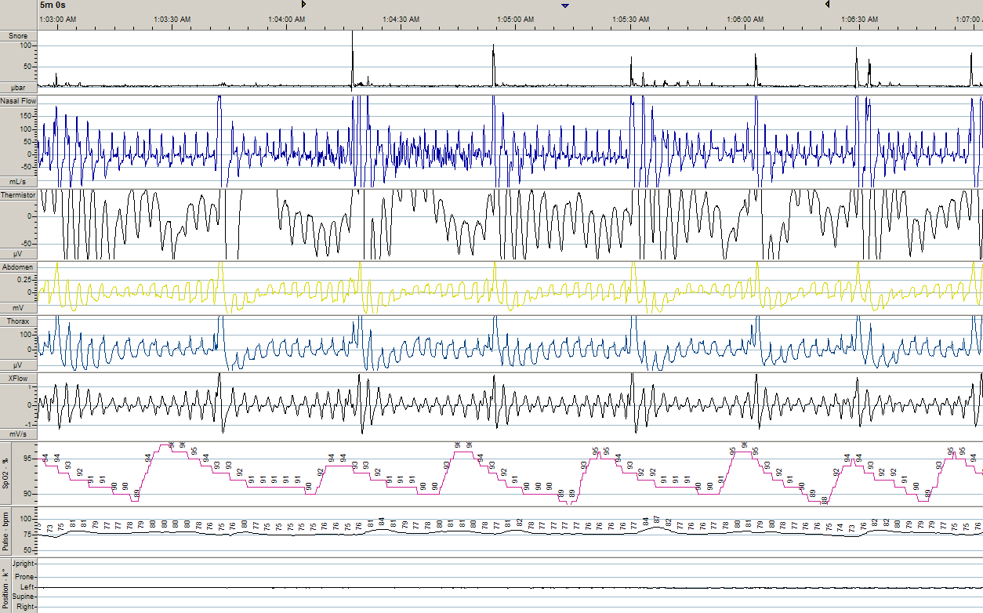
Home Study Tracing
Notes:
55. Redline S, Toreson T, Boucher MA, Millman RP. Measurement of sleep-related breathing disturbances in epidemiologic studies. Assessment of the validity and reproducibility of a portable monitoring device. Chest 1991;100(5):1281-86.
Slide 21
Level 2

Slide 22
Sample OCST Results
Total recording time: 423 minutes
Supine sleep: 34%
AHI 8.4
  3 obstructive apneas, 2 central apneas
Oximetry
  ODI 7
  Nadir saturation 87%, mean 94%
Same patient as in sample PSG but lower AHI estimated b/c of poor sleep efficiency & less REM

Slide 23
Summary
In lab PSG provides details regarding EEG, EMG to give more complete evaluation of sleep disorder
When interpreting sleep study results, remember to consider:
  % supine, REM sleep captured
  AHI often underestimated in OCST
  RDI vs. AHI & hypopnea criteria used

